Slide 1

Simulation of protein folding using Monte Carlo method
Name: Cheung Sing Hoi
Supervisor: Prof. Leung Pakwo
Outline:
Introduction
Importance of protein and protein folding
Simulation model
Results

Slide 2
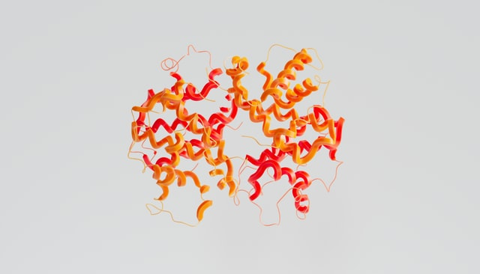
Introduction
Proteins are formed by amino acid
Only 20 of those are used to form a protein
sequence of amino acids will determine all functions and properties that a protein will have
also called primary structure of protein

Slide 3
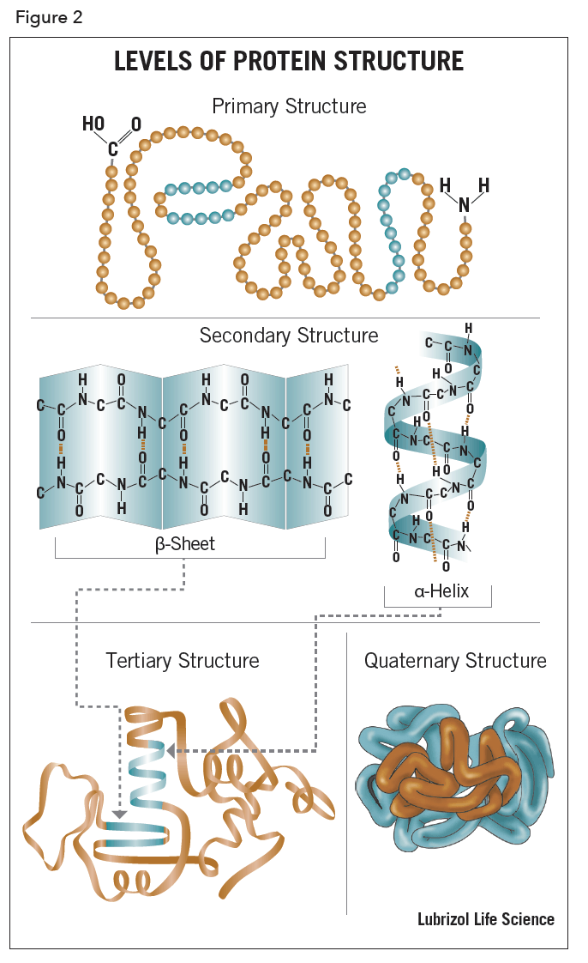
Introduction
As the folding process started, amino acids inside a protein started to interact with each other, and hydrogen bond was formed between amino acids, protein chain was folded into alpha helices or beta-sheets, this state also known as secondary structure.
https://lubrizolcdmo.com/technical-briefs/protein-structure/

Slide 4
Introduction
Tertiary structure is the result of folded the secondary structure sheets or helices into each other. It usually has a polypeptide chain as a backbone, with one or more secondary structures. The tertiary structure is determined by the interactions and bonding of the amino acid side chains in the protein.

Slide 5

Tertiary state
The chemical properties of the sidechains of the amino acids within the protein chain will influence the way that the protein folds in its environment.
When a protein is surrounded by water, Hydrophobic amino acids will move away from the hydrogen and fold themselves in the center of the protein. Hydrophilic amino acids will attracted by the water molecules, thus tend to be located on the outer surface of the protein in a 3D structure. Basic (positively charged) amino acids and Acidic (negatively charged) amino acids will experience electrostatic force from other, either push or pull each other, this further stabilize the tertiary structure

Slide 6
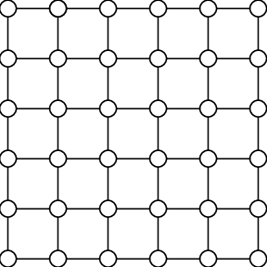
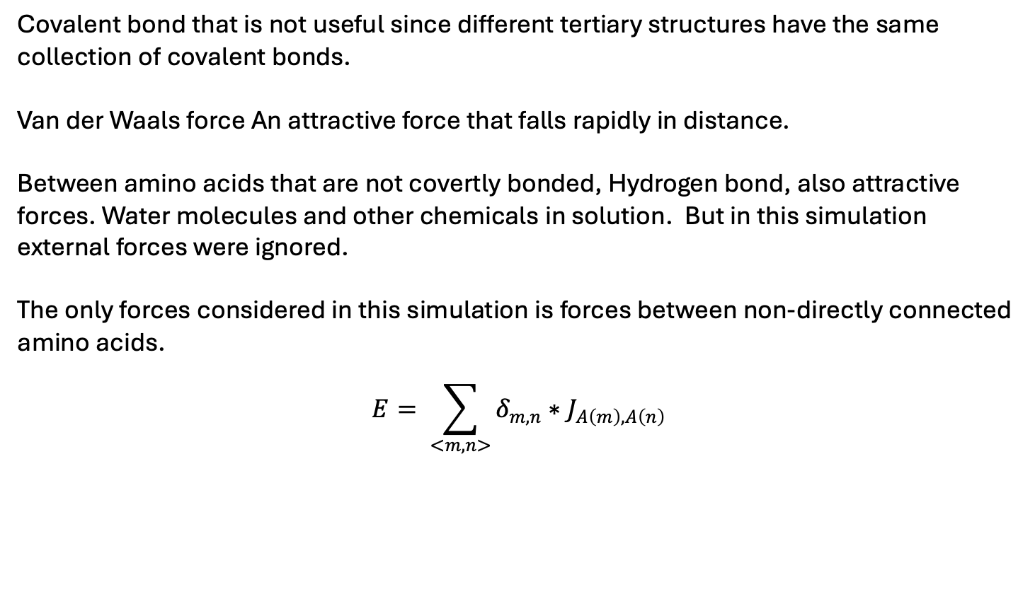
Forces in folding
Covalent bond that is not useful since different tertiary structures have the same collection of covalent bonds.
Van der Waals force An attractive force that falls rapidly in distance.
Between amino acids that are not covertly bonded, Hydrogen bond, also attractive forces. Water molecules and other chemicals in solution. But in this simulation external forces were ignored.
The only forces considered in this simulation is forces between non-directly connected amino acids.
$$E= \sum_{<m,n>}{δ_{m,n}∗J_{A\left(m\right),A\left(n\right)}}$$

Slide 7

Monte Carlo method
1. To start off the folding process, visit every point.
2. At each visit, randomly pick a neighbour from up, down, left and right of the position of the amino acid.
2.1 If it causes overlap or breaking the protein chain, skip it.
2.2 Otherwise, calculate ΔE. Energy calculation is any nearest neighbours without direct connection of covalent bond will have non-zero energy, If ΔE < 0, new state will result lower total energy, so a move was made. If ΔE > 0, only when eq(2) is greater than a random number in 0-1, move is allowed.
Boltzmann factor $e^{\frac{−∆E}{T}}$

Slide 8
Result
Computation time of n =15 is around 5 minutes for 20 difference temperature each have 5x10⁵ steps.
For n = 30, it took 30 minutes, Monte Carlo is not a good method to simulation an even longer protein chain.

Slide 9
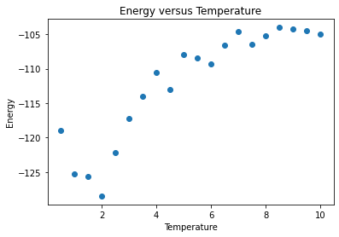
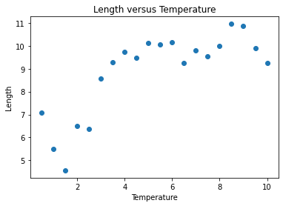
Result
when number of amino acids is 30
energy and end-to-end distance were not obvious in phase transition when temperature change, it is because there are relatively small number of Monte Carlo steps

Slide 10
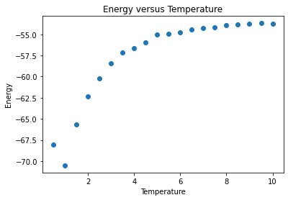
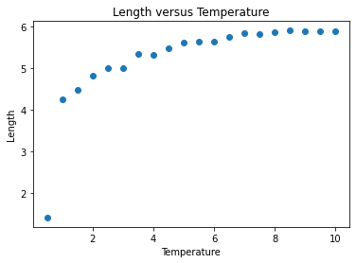
Result
Compare to n = 15, it is clear that a phase transition can be seen, and the critical threshold was about T=2 to T=4.
Which is reasobale

Slide 11
Conclusion
The program was successful in finding the native state of small, n =15 protein sequences.
And it take very long time to compute n = 30 protein sequences.
In real world, important protein folding is simulating much larger length than 30 amino acids.

